Slide 1

A systematic search for absorption features in the X-ray spectra of ultraluminous X-ray sources Andrew Sosanya NASA NuStar team @ Caltech Department of Astrophysics, Caltech Mentors: Fiona A. Harrison & Murray Brightman

Slide 2
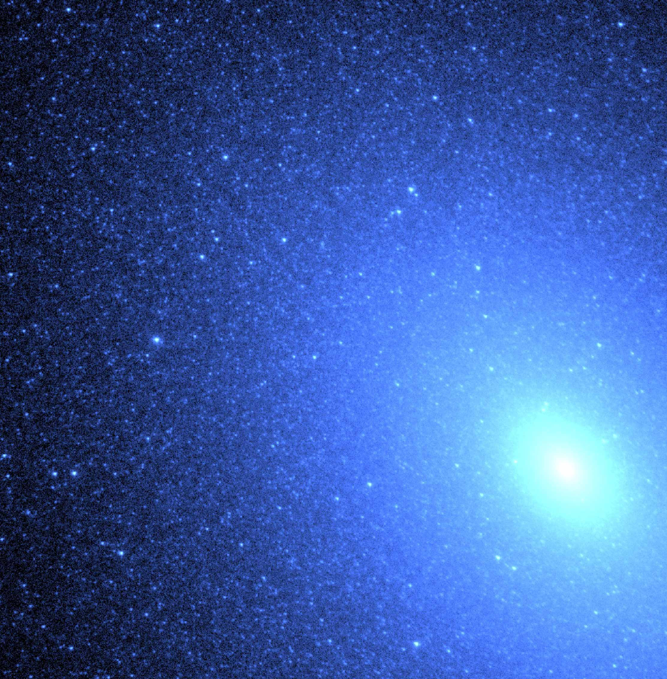
Roadmap
What are ULXs and what’s so interesting about them?
Discovery of pulsations in ULXs -> neutron stars!
Methods: Systematic Search, Spectral Analysis & Statistics
Results: Insight into Analysis of Neutron-star powered ULX candidates
After the search: Discerning the Real from the Fake

Slide 3
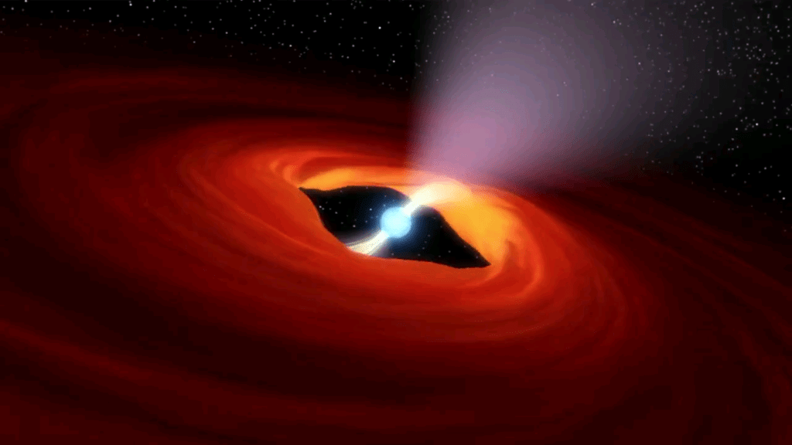
Ultraluminous X-Ray Sources (ULXs)
ULXs are non-nuclear X-ray sources in nearby galaxies that are not associated with the central supermassive black hole or active galactic nucleus.
Unknown mechanism governs most ULX activity. To be found!
Brighter than intergalactic black hole systems and typically radiates at a luminosity of L > 10^39 ergs/s and exceed the Eddington limit for a stellar-mass black hole (10 M⊙).

Slide 4
Put m51 stuff here.

Slide 5


Eddington Luminosity
The accretion limit of a celestial object is the maximum luminosity a star reaches its hydrostatic equillibrium.
The radiation pressure is caused by high temperatures within the star, and gas pressure is low enough such that radiation pressure dominates within certain regions of the star.
A star’s inward gravitational field is balanced by this radiation force.
Can be used to explain the luminosity of accreting black holes.
Consider the hydrostatic equilibrium:
$\frac{dP}{dr}=\frac{kp}{c}F_{rad}$ = $\frac{GMp}{r^{2}}$, where $F=\frac{L}{4πr^{2}}$
We can solve for the Ed.. Limit: $L_{ed}=\frac{4πGc}{k}M$

Slide 6
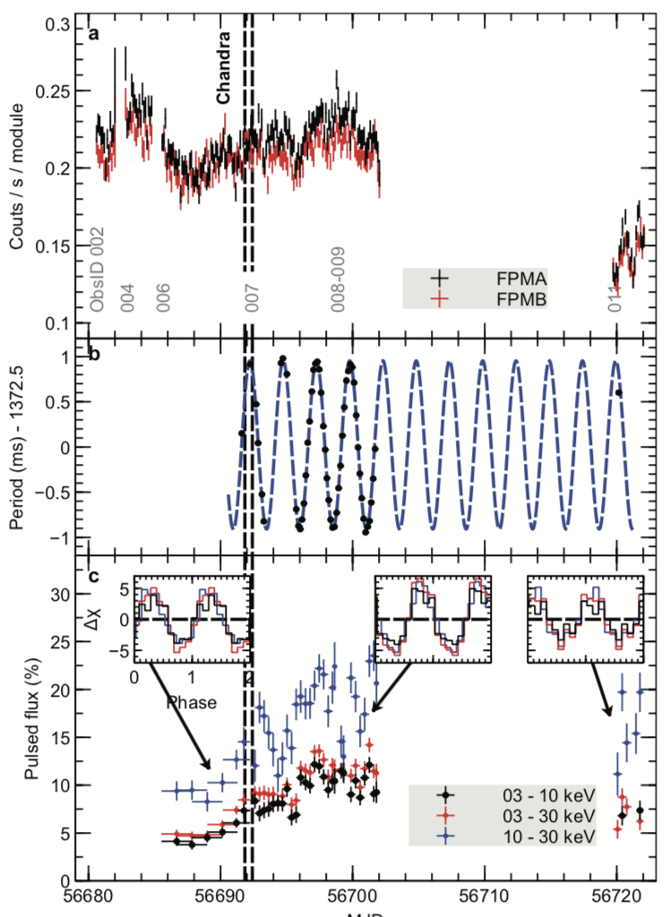
Neutron Star-powered ULXs
Bachetti et al’s 2014 discovery that a neutron star powered M82 X-2 stirred uncertainty about its magnetic field strengths.
Bachetti et al. found that neutron stars may not be a rare occurrence within ULXs.
Put this on separate slide..
Brightman et al estimated the field strength of ULX-8 in M51 to be on order of 10^15 G

Slide 7
Our Mission
Identify neutron star-powered ULXs by locating proton cyclotron resonance scattering features (CRSFs) (Mihara et al, Tiengo et al) via analysis of Chandra & XMM data
Find more distinguishing factors as the cause of super-Eddington luminosity (field strength,mass, luminosity as a determinant)
Precisely measure the magnetic fields of such ULXs (Mihara et al, 1974)
Notes:
CSRFs produced by the transition of charged particles between quantized Landau levels

Slide 8
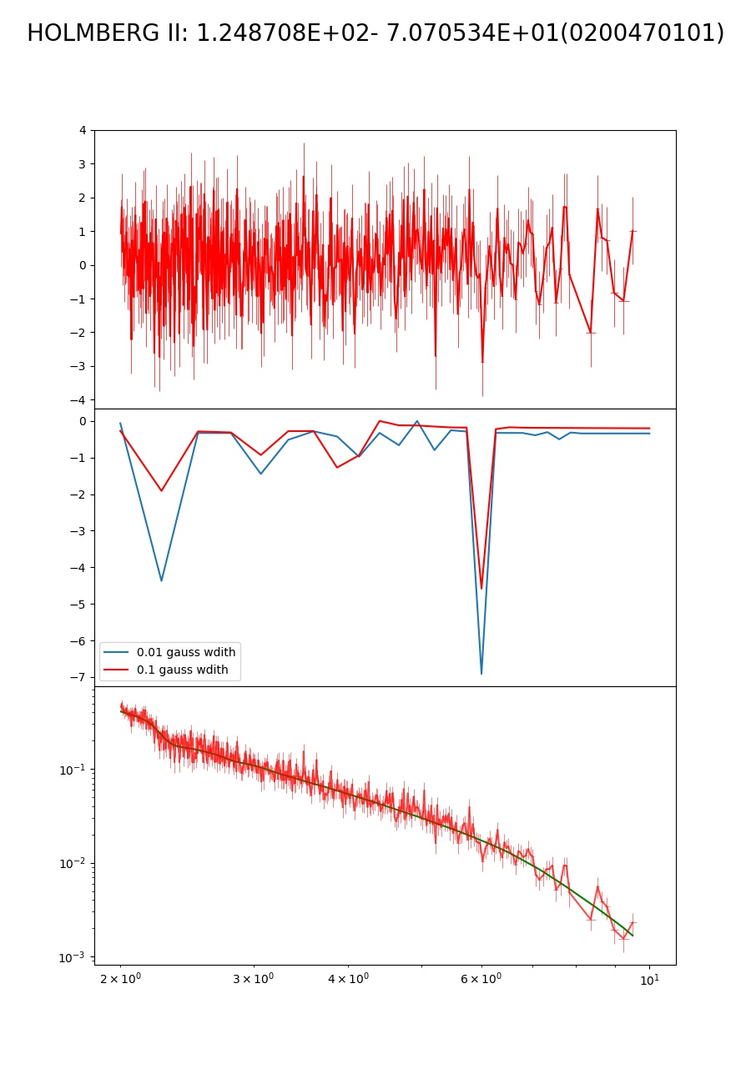
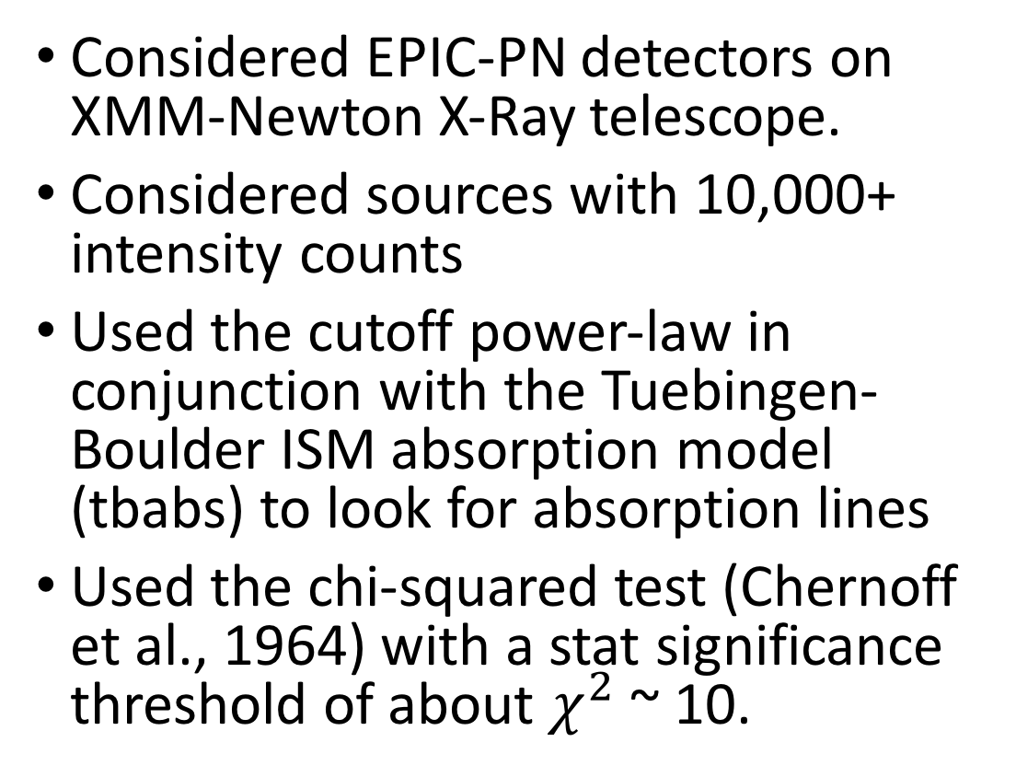
Spectral analysis via XSPEC, fit with absorption models.
Considered EPIC-PN detectors on XMM-Newton X-Ray telescope.
Considered sources with 10,000+ intensity counts
Used the cutoff power-law in conjunction with the Tuebingen-Boulder ISM absorption model (tbabs) to look for absorption lines
Used the chi-squared test (Chernoff et al., 1964) with a stat significance threshold of about $χ^{2}$ ~ 10.

Slide 9
Promising Candidate: M32(NGC 221)
Satellite Galaxy of M31, the Andromeda Galaxy

Slide 10
Potential Challenges
Determining proper parameters to fit our absorption model with to get a better look at features.
Finding better reduction parameters.
Differentiating between atomic absorption vs proton CSRFs.
Dealing with detector issues.
Data required for pulsations & harmonic lines -> More observations needed

Slide 11
Acknowledgements
WAVE Program

